Slide 1
Network Sniffing &
Wifi Hacking
Presenting Bilal & Haris

Slide 2
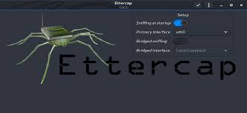
ARP Spoofing and MITM Attacks
Definition: ARP (Address Resolution Protocol) spoofing involves sending fake ARP messages to a network. This causes the ARP cache of devices to associate the attacker’s MAC address with an IP address belonging to another device.
Impact: Can lead to various attacks including MITM (Man-in-the-Middle) attacks, where the attacker can intercept and alter communications between devices.
Example Tools:
Ettercap
Cain & Abel
Demonstration: Setting up ARP spoofing using Ettercap.

Slide 3
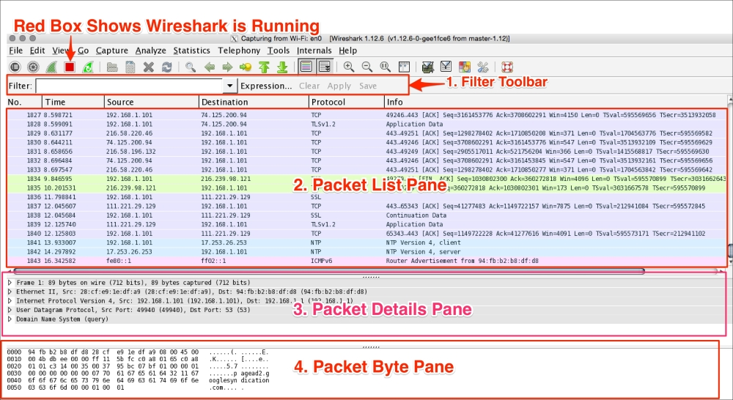
MITM Attacks
Definition: MITM attacks involve an attacker secretly intercepting and possibly altering communications between two parties.
Techniques:
ARP Spoofing (as mentioned above).
DNS Spoofing: Redirecting DNS queries to malicious sites.
Demonstration: How to conduct a MITM attack and its consequences using Bettercap.
Example Tools:
Wireshark
Bettercap

Slide 4
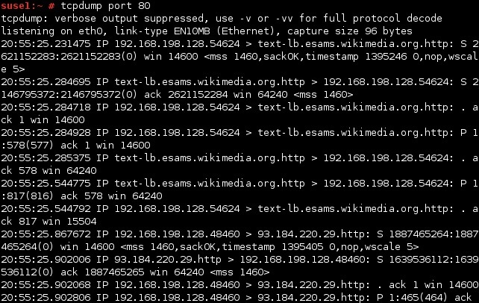
VoIP Traffic Sniffing and
Sniffing for Malware Traffic
VoIP Traffic Sniffing:
Definition: VoIP (Voice over IP) traffic sniffing involves capturing and analyzing voice communications transmitted over IP networks.
Challenges: VoIP traffic is often encrypted or uses non-standard ports, making it more complex to analyze.
Example Tools:
Wireshark: Can decode and analyze VoIP protocols like SIP and RTP.
Tcpdump: Useful for capturing packets and analyzing VoIP traffic.
Demonstration: Capturing VoIP traffic and analyzing it using Wireshark.

Slide 5


Sniffing for Malware Traffic
Definition: Monitoring network traffic to detect indicators of malware activity.
Indicators: Unusual traffic patterns, known malicious IP addresses, or traffic to uncommon ports.
Example Tools:
Snort: An open-source intrusion detection system that can be configured to detect malicious traffic.
Suricata: Another powerful IDS/IPS tool.
Note: that these tools are mostly used for blue team and defensive security and
it is important as an Ethical Hacker to know about these concepts.

Slide 6
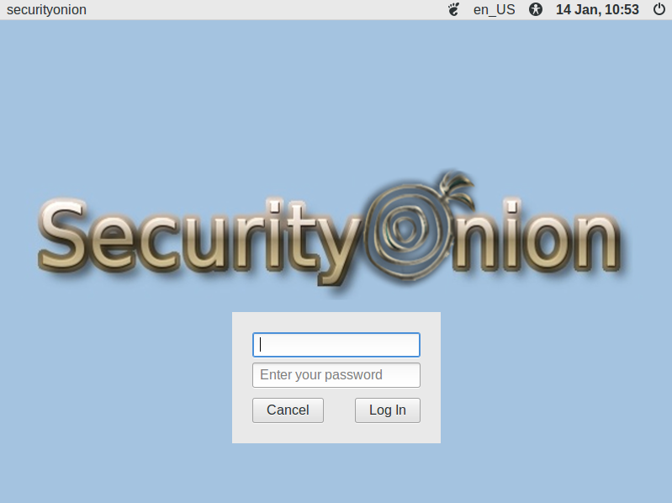

Network Sniffing for Intrusion Detection and Building Custom Sniffing Tools
Definition: Using sniffing tools to monitor network traffic for signs of unauthorized or suspicious activity.
Types of Intrusions:
Port Scanning: Detection of port scanning activities.
Protocol Analysis: Identifying misuse of protocols.
Example Tools:
Zeek (formerly Bro): Provides detailed network monitoring and intrusion detection.
Security Onion: A Linux distro that includes a range of IDS/IPS tools.

Slide 7
Building Custom Sniffing Tools
Purpose: Developing tailored sniffing tools to address specific needs or scenarios.
Languages: Python, Go, and C++ are popular choices for developing network sniffing tools.
Example Tools:
Scapy: A powerful Python library for packet manipulation.
Pyshark: A Python wrapper for TShark (part of Wireshark).
Demonstration: Writing a simple custom packet sniffer in Python using Scapy.

Slide 8
Sniffing Case Studies and Real-World Scenarios
Sniffing Case Studies:
Case Study 1: Analysis of a real-world ARP spoofing attack and its impact.
Case Study 2: Examination of a VoIP attack and the methods used to detect and mitigate it.
Case Study 3: Review of a malware traffic sniffing scenario and response strategies.

Slide 9
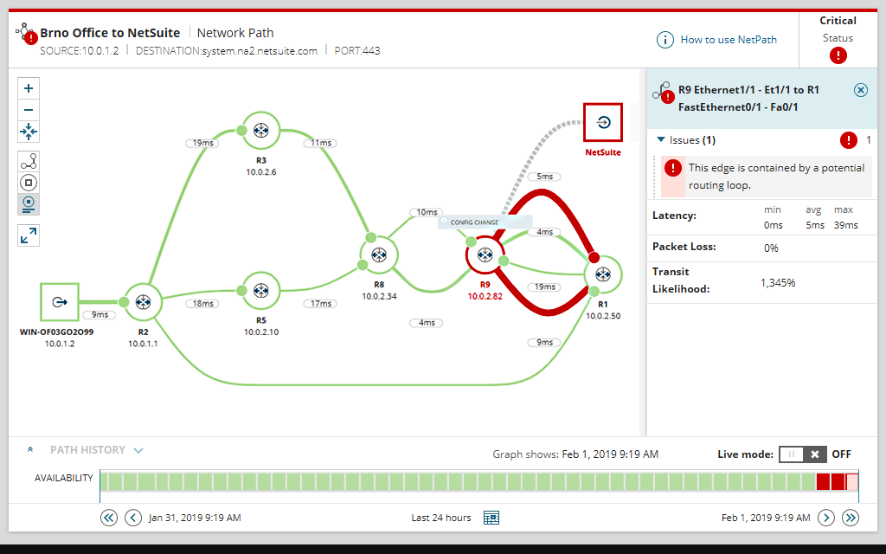
Sniffing for Security and Troubleshooting
Security: Using sniffing to ensure secure communications and detect vulnerabilities.
Troubleshooting: Identifying network issues such as congestion, misconfigurations, and performance bottlenecks.
Example Tools:
SolarWinds Network Performance Monitor: For troubleshooting network performance issues.
PRTG Network Monitor: Offers comprehensive network monitoring and troubleshooting features.

Slide 10

Sniffing Best Practices and Avoiding Detection
Best Practices:
Legal Compliance: Ensure all sniffing activities are authorized and legal.
Data Privacy: Respect privacy and avoid capturing sensitive information without consent.
Avoiding Detection:
Stealth Techniques: Use techniques to minimize detection while sniffing, such as packet fragmentation or traffic obfuscation.
Example Tools:
Nmap: Can be used to scan and identify potential security risks without being detected.

Slide 11
End of Today’s Lecture.
Assignments, Presentations, CTF and today’s practical demonstration.

